Slide 1
An Analysis on CO2 Emissions of Vehicles from 2000 to 2014
B.Darji
J.Moorthy
J.Hum
M.Ly
L.Djinde
York University
CSDA1110 Introduction to Data Science H.Sangwan
May 3rd, 2024
1

Slide 2
Table of Contents
Executive Summary……………….………………………………………………………........3
Introduction….…………………………………………………………………………………...4 Basic Analysis………………….……………………………………………………...……......4 Modeling and Analysis………….................................................................................…...6
Conclusion…………………………………………………………………………...................8
Appendices………………………………………………………………………......................9
2

Slide 3
Executive Summary
The following report is a thorough analysis of CO2 emissions produced by cars and various features of a car that bolster the effects of its production. This report is mandated by the Ministry of Environment XYZ in order to help analyze and provide recommendations for the reduction of CO2 emissions of cars. We firstly analyzed the data using descriptive analytics and preliminary analysis, then we dive into modeling to reinforce these analyses, and lastly provide recommendations as a result. We aimed to answer 5 key business questions in our analysis:
What are different characteristics of cars that increase or decrease the rate of CO2 production?
Does the size of the engine play a determinant role on the CO2 emissions amount?
What are the top 3 classes of engines that we should stop producing to preserve the environment?
Top 3 ecological model engines which produce the lowest CO2 emissions between 2010 and 2014?
Top 5 brands which produce engines with low CO2 and can be recommended to the public?
We were able to conclude that major components and features of the car which include engine size, number of cylinders, model year and various fuel consumptions on various roads contributed to a significant increase in CO2 emissions. As recommendations, we recommend that buyers avoid the Chevrolet brand and lean toward Volkswagen. We also recommend the buyer to be conscious of the mentioned features that are heavy contributors to car CO2 emissions. Lastly, in regards to the Ministry of Environment, we recommend the continued investment in R&D and public awareness.
3

Slide 4
Introduction
We live in a world marked by exponential population growth, where consumption is at its peak and so is pollution.The urgency to find sustainable solutions has never been more pressing. Thanks to the advancing technologies and innovation, we will be able to build more efficient ways to consume.
In the following sections, we will dive into the analysis starting with basic analysis of descriptive analytics exploring the dataset. Then getting into the model used to analyze the data further. Through these analyses, we will explain the process and what we can draw from these insights. That will lead us to be able to make recommendations and provide answers to the business questions.
Basic Analysis
Descriptive Statistics Interpretation:
Count: All columns have a count of 14,252, indicating no missing values in the dataset for these measures.
Model Year:
Range: 2000 to 2014, suggesting the dataset covers cars manufactured within these years.
Median (50%): 2008, indicating that half of the cars were made on or before 2008 and half after.
Engine Size (in liters):
Range: 0.8 to 8.4 liters, showing a wide variety of engine sizes.
Mean: Approximately 3.48 liters, suggesting the average engine size is moderately large.
Median: 3.4 liters, very close to the mean, indicating a fairly symmetrical distribution of engine sizes around the middle value.
4

Slide 5
Cylinders:
Range: 2 to 16 cylinders, indicating a variety from small to highly powerful engines.
Mean and Median: Slightly below 6 and exactly 6 respectively, suggesting most cars have around 6 cylinders.
Fuel Consumption (in L/100KM):
City Driving:
Mean: 12.93, Median: 12.4 - indicating average city consumption is relatively high, reflecting less fuel efficiency in city driving.
Highway Driving:
Mean: 8.83, Median: 8.3 - lower than city driving, showing better fuel efficiency on highways.
Combined:
Mean: 11.09, Median: 10.5 - a weighted average of city and highway driving, slightly skewed towards city consumption patterns.
Fuel Consumption (in MPG) - Combined:
Range: 11 to 78 MPG, showing a vast difference in fuel efficiency among vehicles.
Mean: 27.29 MPG, which suggests moderate fuel efficiency across the dataset.
CO2 Emissions (in G/KM):
Range: 83 to 570 G/KM, indicating a significant variance in emission levels, from eco-friendly to highly polluting vehicles.
Mean: 248.78 G/KM, suggesting a moderate level of emissions on average.
Median: 239 G/KM, slightly lower than the mean, indicating that more than half of the vehicles have emissions below the average, yet close enough to suggest a normal distribution.
5

Slide 6
Normal Distribution of the Variables: The variables are not normally distributed since the p-values are less than 0.05.
Modeling and Analysis
For our model, we have decided to use the K-means clustering algorithm to group the data points based on their respective CO2 emissions, City Fuel Consumption and Highway Fuel Consumption.
Firstly, in order to perform K-means clustering properly, we will need to normalize the data. We then are able to come up with the optimal number of clusters that would segment our data into sections. The Elbow Method plot (see Appendix 1) shows the optimal number of clusters is indeed 3 as it presents the sharpest angle. Using this number of clusters, we proceed to fit the K-means model to our normalized dataset.
In order to evaluate our model, we can use several key metrics for this: Inertia (Within-Cluster Sum of Squares WCSS), Silhouette score, Davies-Bouldin Index and Calinski-Harabasz Index (see Appendix 2).
Limitations of the model and data:
A first limitation is in the choice of number of clusters. The Elbow Method can be subjective and inaccurate for large and complex datasets. There are other complex ways that can determine the optimal number of clusters that can be more appropriate and applied to this dataset as an improvement. Another limitation is choosing the optimal clustering algorithm for the dataset. K-means often assumes the clusters to be in the shape of spheres and in our case, the clusters were not as spherical as anticipated. The data also contained many non-numeric variables which can be hard to analyze and would need to be further manipulated to be used in the model. Overall, clustering algorithms can be difficult as well to interpret but we were able to draw insights from the model to help us address the business questions.
Key Recommendations:
6

Slide 7
Firstly, we were able to aggregate the clusters by mean CO2 emissions (see Appendix 3). We can see that cars in Cluster 0 produce the highest level of CO2 with an average of 320.1 G/KM and the lowest producing cluster is Cluster 2 with 174.6 G/KM. Furthermore, we are able to see that fuel consumption values are the highest in Cluster 1 as well.
We can draw more insight from grouping and aggregating the cluster data, and we can determine the top 3 engine sizes per cluster. We can see that Cluster 0 containing the highest average emissions has larger engine size 5.3, 4.0 and 4.3, in comparison to the lowest Cluster 2 which has engine sizes 2.0, 1.6, 2.4. We recommend here that bigger engines should seize production (see Appendix 4).
Another insight we can draw from this is the top brand from each cluster. This will show us which brand contributes the most to high CO2 emissions and which brand has the most ecological cars on the other hand (see Appendix 5). We observe here that Chevrolet is the most prominent brand in Cluster 0 which has the highest emissions and Volkwagen has the most cars that produce the least amount of CO2. From this, we recommend that purchasers consider buying a Volkswagen as it is seen to produce less harmful cars to the environment and to also stay away from Chevrolet vehicles.
We can see that the majority of cars in Cluster 0 which emitted the highest CO2 are from the early 2000s (see Appendix 6). We can observe that cars in Cluster 2 which emitted the least are all models from after 2010. We can see that newer cars emit less CO2 due to technology advancements.
We also created several boxplots that include all 3 clusters that we can then use to compare to one another (see Appendix 7). In this boxplot, we can visualize that the cluster with the highest CO2 emission (Cluster 0) has the highest mean, median and mode as well as minimum and maximum values. We can say that engine size does play a clear role in the amount of CO2 produced.
Finally, we can deduce which characteristics of cars increase the rate of production of CO2. We have created this first plot to visualize this (see Appendix 8 and
7

Slide 8
Appendix 9). In the first visual, we can see that cars with larger engine sizes and more cylinders contribute to higher CO2 emissions. In the same way, the second visual shows that the more fuel consumption per 100KM, the more CO2 is produced. We see the cluster of blue points which is Cluster 0 (highest mean CO2 emissions) grouped more toward the top right of the graph. The red points of Cluster 2 (lowest mean CO2 emissions) are sitting more towards the bottom left of the graph. Cluster 1 which is green has its data points hovering more near the middle. We can conclude from this that the increase of fuel consumption, engine size and cylinders will contribute to the increase of CO2 emissions rate of production. We recommend that one ensures that these 3 characteristics have lower values when purchasing a car.
Conclusion
In conclusion, our consultancy firm, in partnership with the Ministry of Environment XYZ, helped address the business questions in regard to reducing CO2 emissions from vehicles by analyzing the data through exploratory and modeling techniques. We were able to conclude that factors such as engine size, fuel consumption rates on different roads and number of cylinders all contribute to high production of CO2 when values are increased.
In terms of recommendations, we recommend firstly that buyers veer toward Volkswagen and avoid Chevrolet when selecting a brand. Secondly, we recommend that buyers look out for features such as fuel consumption, cylinders, engine size and model year that heavily influence higher emissions of CO2. In regard to the Ministry of Environment XYZ, we recommend that it invests into new technology that can keep these feature values high while being more environmentally friendly. Buyers want to have the experience of a powerful and fun car to drive but it should not come at the expense of our planet. We can already see a trend of new cars being more environmentally friendly while keeping their luxurious features and in order to keep this up, investments in R&D and public awareness are crucial and highly advised.
8

Slide 9
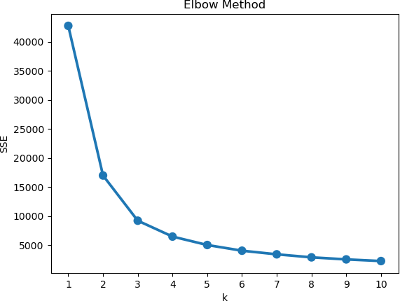
Appendices
Appendix 1)
Appendix 2)
Model Metrics
Metric | Explanation | Value
Inertia (WCSS) | This measures the variability within each cluster | Value of 2240.42 which is high but can be explained by the large amount of data points
Silhouette Score | This quantifies the similarity a data point is to its respective cluster compared to other clusters | The silhouette score ranges from -1 to 1 and we obtained a positive score of 0.43
9

Slide 10
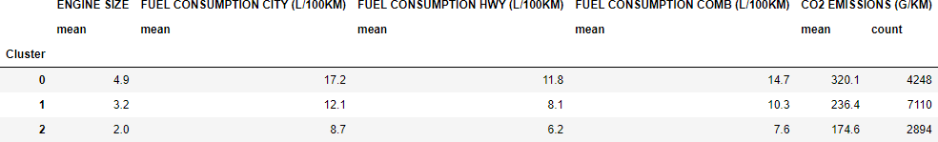
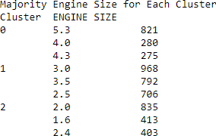
Davies-Bouldin Index | This measures the similarity between each cluster and the most similar cluster to it | Lowest possible value is favourable and achieved a value of 0.67 which indicates a good model
Calinski-Harabasz Index | This calculates the ratio of how dispersed the data points are between each cluster to how dispersed the points are within each cluster | High value is favourable for this metric and we have a value of 28618.68 for our model which is a good indicator
Appendix 3)
Aggregate Statistics of Clusters
Appendix 4)
10

Slide 11

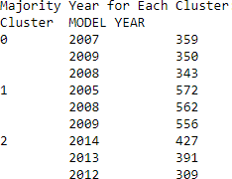
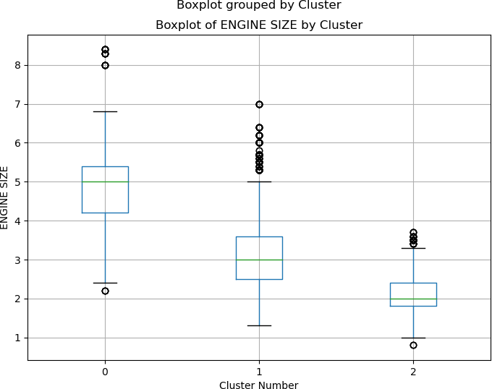
Appendix 5)
Appendix 6)
Appendix 7)
11

Slide 12
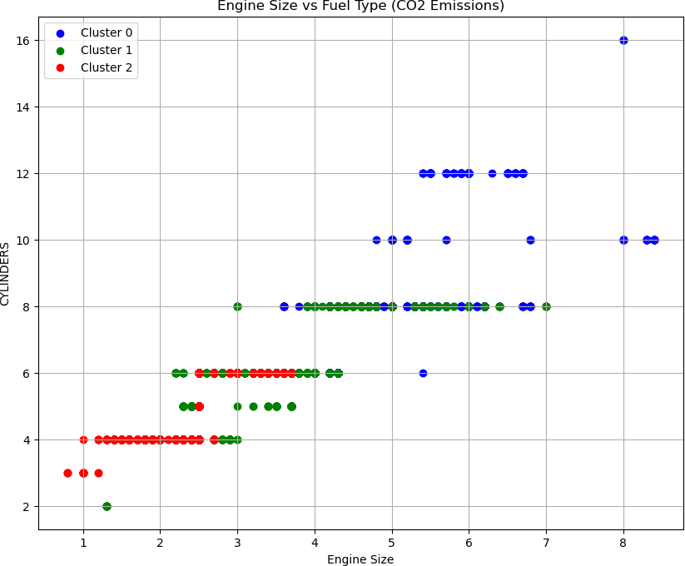
Appendix 8)
12

Slide 13
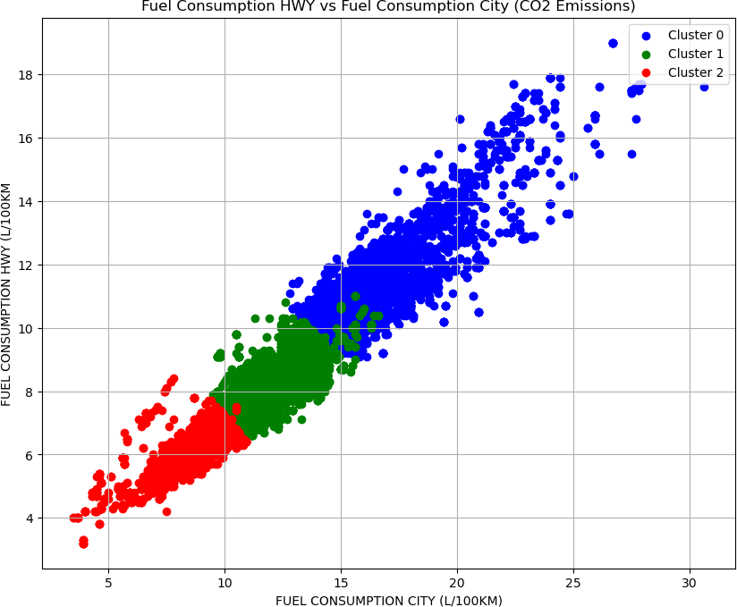
Appendix 9)
13

Slide 14
Description of the dataset
The dataset we are using was collected from the website: OpenCanada.ca. It provides the emission of CO2 by car according to the Make, the Year, the Model the Vehicle class , the engine Size, the transmission and the cylinders. The dataset also provide information about the type of fuel that each engines use and the quantity of fuel consumption in city, in highway, and the combine.
CO2 emissions are estimated tailpipe carbon dioxide emissions (in grams per kilometre) are based on fuel type. Legend of the Dataset:
Model:
4WD/4X4 = Four-wheel drive AWD = All-wheel drive
CNG = Compressed natural gas FFV = Flexible-fuel vehicle NGV = Natural gas vehicle
'#' = High output engine that provides more power than the standard engine of the same size
Transmission
A = Automatic
AM = Automated manual
AS = Automatic with select shift AV = Continuously variable-
M = Manual
3 – 10 = Number of gears.
Fuel Type
X = Regular gasoline Z = Premium gasoline D = Diesel

Slide 15
E = Ethanol (E85) N = Natural Gas
City and highway fuel consumption ratings are shown in litres per 100 kilometres (L/100) - combined rating (55% city, 45% hwy) is shown in L/100 km and in miles per imperial gallon (mpg)
Importing package and Excel file
In [1]:
import numpy as np import pandas as pd import seaborn as sns
from matplotlib import pyplot as plt
from sklearn.preprocessing import StandardScaler
from sklearn.cluster import KMeans
import warnings
import statistics as stat warnings.filterwarnings("ignore")
In [2]:
# Import the excel Dataset file and rename columns
df_cars = pd.read_excel(r"Co2-Emission-Data.xlsx",
header=1, names=['MODEL YEAR','MAKE','MODEL','VEHICLE CLASS', 'ENGINE SIZE',
'CYLINDERS','TRANSMISSION','FUEL TYPE', 'FUEL CONSUMPTION CITY (L/100KM)', 'FUEL CONSUMPTION HWY (L/100KM)',
'FUEL CONSUMPTION COMB (L/100KM)',
'FUEL CONSUMPTION COMB (MPG)',
'CO2 EMISSIONS (G/KM)'], skiprows=0)
df_cars.head()

Slide 16
Out[2]:
FUEL
FUEL
 | MODEL YEAR | MAKE | MODEL | VEHICLE CLASS | ENGINE SIZE | CYLINDERS | TRANSMISSION | FUEL TYPE | CONSUMPTION CITY | CONSUMPTION HWY | CONSUMP
 |  |  |  |  |  |  |  |  | (L/100KM) | (L/100KM) | (L/10
0 | 2000 | ACURA | 1.6EL | COMPACT | 1.6 | 4 | A4 | X | 9.2 | 6.7
1 | 2000 | ACURA | 1.6EL | COMPACT | 1.6 | 4 | M5 | X | 8.5 | 6.5
2 | 2000 | ACURA | 3.2TL | MID-SIZE | 3.2 | 6 | AS5 | Z | 12.2 | 7.4
3 | 2000 | ACURA | 3.5RL | MID-SIZE | 3.5 | 6 | A4 | Z | 13.4 | 9.2
4 | 2000 | ACURA | INTEGRA | SUBCOMPACT | 1.8 | 4 | A4 | X | 10.0 | 7.0
In [3]:
#Length of the dataset before the cleaning
len(df_cars)
Out[3]:
14253
In [4]:
df_cars = pd.DataFrame(df_cars)
Cleaning the Dataset
In [6]:
#Check non values
df_cars.isnull().sum()
Out[6]:
MODEL YEAR MAKE
MODEL
VEHICLE CLASS ENGINE SIZE CYLINDERS TRANSMISSION FUEL TYPE
FUEL CONSUMPTION CITY (L/100KM) FUEL CONSUMPTION HWY (L/100KM) FUEL CONSUMPTION COMB (L/100KM)
FUEL CONSUMPTION COMB (MPG) CO2 EMISSIONS (G/KM)
dtype: int64
0
0
0
0
0
0
0
0
0
0
0
0
0

Slide 17
In [5]:
#Verification of the Data Types
df_cars.info()
<class 'pandas.core.frame.DataFrame'> RangeIndex: 14253 entries, 0 to 14252 Data columns (total 13 columns):
# Column
Non-Null Count
Dtype
0 MODEL YEAR |  |  | 14253 | non-null |  | int64
1 MAKE |  |  | 14253 | non-null |  | object
2 MODEL |  |  | 14253 | non-null |  | object
3 VEHICLE CLASS |  |  | 14253 | non-null |  | object
4 ENGINE SIZE |  |  | 14253 | non-null |  | float64
5 CYLINDERS |  |  | 14253 | non-null |  | int64
6 TRANSMISSION |  |  | 14253 | non-null |  | object
7 FUEL TYPE |  |  | 14253 | non-null |  | object
8 FUEL CONSUMPTION |  | CITY (L/100KM) | 14253 | non-null |  | float64
9 FUEL CONSUMPTION |  | HWY (L/100KM) | 14253 | non-null |  | float64
10 FUEL CONSUMPTION |  | COMB (L/100KM) | 14253 | non-null |  | float64
11 FUEL CONSUMPTION |  | COMB (MPG) | 14253 | non-null |  | int64
12 | CO2 EMISSIONS (G/KM) |  | 14253 | non-null | int64
dtypes: float64(4), int64(4), object(5) memory usage: 1.4+ MB
In [8]:
#Duplicates values
df_cars[df_cars.duplicated(keep=False)]
Out[8]:
MODEL YEAR
VEHICLE ENGINE CLASS SIZE
FUEL FUEL
MAKE
MODEL
CYLINDERS TRANSMISSION
FUEL CONSUMPTION CONSUMPTION CONSUMP
TYPE CITY HWY
 |  |  |  |  |  | (L/100KM) | (L/100KM) | (L/10
_{LAND} DISCOVERY 377 2000 _{ROVER} SERIES II | SUV | 4.0 | 8 | A4 | Z | 17.7 | 12.7
4X4
_{LAND} DISCOVERY 378 2000 _{ROVER} SERIES II | SUV | 4.0 | 8 | A4 | Z | 17.7 | 12.7
4X4
In [9]:
#Remove duplicates values
df_cars = df_cars.drop_duplicates() len(df_cars)

Slide 18
Out[9]:
14252
In [10]:
df_cars.head()
Out[10]:
FUEL FUEL
 | MODEL YEAR | MAKE | MODEL | VEHICLE CLASS | ENGINE SIZE | CYLINDERS | TRANSMISSION | FUEL TYPE | CONSUMPTION CITY | CONSUMPTION HWY | CONSUMP
 |  |  |  |  |  |  |  |  | (L/100KM) | (L/100KM) | (L/10
0 | 2000 | ACURA | 1.6EL | COMPACT | 1.6 | 4 | A4 | X | 9.2 | 6.7
1 | 2000 | ACURA | 1.6EL | COMPACT | 1.6 | 4 | M5 | X | 8.5 | 6.5
2 | 2000 | ACURA | 3.2TL | MID-SIZE | 3.2 | 6 | AS5 | Z | 12.2 | 7.4
3 | 2000 | ACURA | 3.5RL | MID-SIZE | 3.5 | 6 | A4 | Z | 13.4 | 9.2
4 | 2000 | ACURA | INTEGRA | SUBCOMPACT | 1.8 | 4 | A4 | X | 10.0 | 7.0
In [11]:
df_cars.describe()
Out[11]:
MODEL YEAR ENGINE SIZE CYLINDERS |  |  |  | FUEL CONSUMPTION CITY (L/100KM) | FUEL CONSUMPTION HWY (L/100KM) | FUEL CONSUMPTION COMB (L/100KM) | FUEL CO2 CONSUMPTION EMISSIONS COMB (MPG) (G/KM)
count | 14252.000000 | 14252.000000 | 14252.000000 | 14252.000000 | 14252.000000 | 14252.000000 | 14252.000000 | 14252.000000
mean | 2007.592408 | 3.477814 | 5.991089 | 12.934122 | 8.831076 | 11.089335 | 27.286276 | 248.782767
std | 4.132526 | 1.311141 | 1.774136 | 3.541339 | 2.338027 | 2.969369 | 7.425763 | 59.072688
min | 2000.000000 | 0.800000 | 2.000000 | 3.500000 | 3.200000 | 3.600000 | 11.000000 | 83.000000
25% | 2004.000000 | 2.400000 | 4.000000 | 10.600000 | 7.200000 | 9.100000 | 22.000000 | 209.000000
50% | 2008.000000 | 3.400000 | 6.000000 | 12.400000 | 8.300000 | 10.500000 | 27.000000 | 239.000000
75% | 2011.000000 | 4.400000 | 8.000000 | 14.900000 | 10.200000 | 12.800000 | 31.000000 | 285.000000
max | 2014.000000 | 8.400000 | 16.000000 | 30.600000 | 19.000000 | 24.800000 | 78.000000 | 570.000000
In [12]:
#Convert of the data types in float64
df_cars[['CYLINDERS','FUEL CONSUMPTION COMB (MPG)','CO2 EMISSIONS (G/KM)']] = df_cars[['CYLINDERS',

Slide 19
'FUEL CONSUMPTION COMB (MPG)','CO2 EMISSIONS (G/KM)']].apply(np.float64)
display(df_cars.dtypes)
MODEL YEAR MAKE
MODEL
VEHICLE CLASS
ENGINE SIZE CYLINDERS TRANSMISSION FUEL TYPE
FUEL CONSUMPTION CITY (L/100KM) FUEL CONSUMPTION HWY (L/100KM) FUEL CONSUMPTION COMB (L/100KM) FUEL CONSUMPTION COMB (MPG)
CO2 EMISSIONS (G/KM)
dtype: object
int64 object object object float64 float64 object object float64 float64 float64 float64 float64
Create a new variable 'EMISSION CATEGORY' : By categorizing the vehicles based on their CO2 emissions into low, medium, and high categories
In [13]:
bins = [0, 160, 255, float('inf')]
labels = ['Low', 'Medium', 'High']
df_cars['EMISSION CATEGORY'] = pd.cut(df_cars['CO2 EMISSIONS (G/KM)'], bins=bins,
labels=labels)
# Display the first few rows to verify the new variable Emission Category
df_cars.head()

Slide 20
Out[13]:
FUEL
FUEL
 | MODEL YEAR | MAKE | MODEL | VEHICLE CLASS | ENGINE SIZE | CYLINDERS | TRANSMISSION | FUEL TYPE | CONSUMPTION CITY | CONSUMPTION HWY | CONSUMP
 |  |  |  |  |  |  |  |  | (L/100KM) | (L/100KM) | (L/10
0 | 2000 | ACURA | 1.6EL | COMPACT | 1.6 | 4.0 | A4 | X | 9.2 | 6.7
1 | 2000 | ACURA | 1.6EL | COMPACT | 1.6 | 4.0 | M5 | X | 8.5 | 6.5
2 | 2000 | ACURA | 3.2TL | MID-SIZE | 3.2 | 6.0 | AS5 | Z | 12.2 | 7.4
3 | 2000 | ACURA | 3.5RL | MID-SIZE | 3.5 | 6.0 | A4 | Z | 13.4 | 9.2
4 | 2000 | ACURA | INTEGRA | SUBCOMPACT | 1.8 | 4.0 | A4 | X | 10.0 | 7.0
Conversion of Fuel Comsumption HWY and CITY in MPG
In [14]:
# MPG = 282.48/ xL/100KM
df_cars["FUEL CONSUMPTION CITY (MPG)"] = 282.48/df_cars["FUEL CONSUMPTION CITY (L/100KM)"] df_cars["FUEL CONSUMPTION HWY (MPG)"] = 282.48/df_cars["FUEL CONSUMPTION HWY (L/100KM)"]
df_cars

Slide 21
Out[14]:
MODEL YEAR
VEHICLE CLASS
ENGINE
SIZE
FUEL TYPE
FUEL CONSUMPTION
CITY
(L/100KM)
FUEL CONSUMPTION CON
HWY
(L/100KM)
MAKE
MODEL
CYLINDERS
TRANSMISSION
0 2000 ACURA 1.6EL COMPACT 1.6 4.0 A4 X 9.2 6.7
1 2000 ACURA 1.6EL COMPACT 1.6 4.0 M5 X 8.5 6.5
2 2000 ACURA 3.2TL MID-SIZE 3.2 6.0 AS5 Z 12.2 7.4
3 2000 ACURA 3.5RL MID-SIZE 3.5 6.0 A4 Z 13.4 9.2
4 2000 ACURA INTEGRA SUBCOMPACT 1.8 4.0 A4 X 10.0 7.0
... ... ... ... ... ... ... ... ... ... ...
14248 2014 VOLVO
XC60 AWD
SUV - SMALL 3.0 6.0 AS6 X 11.9 8.3
14249
2014 VOLVO
XC60 AWD
SUV - SMALL
3.2
6.0
AS6
X
11.7
8.0
14250
2014 VOLVO
XC70 AWD
SUV - SMALL
3.0
6.0
AS6
X
11.9
8.3
14251
2014 VOLVO
XC70 AWD
SUV - SMALL
3.2
6.0
AS6
X
11.4
7.8
14252
2014 VOLVO
XC90 AWD
SUV - STANDARD
3.2
6.0
AS6
X
13.3
8.6
14252 rows × 16 columns
Basic Analysis
In [15]:
# Summary of the statistics of Dataset to understand different value like mean, min, max, etc.:
df_cars.describe()

Slide 22
Out[15]:
MODEL YEAR ENGINE SIZE CYLINDERS |  |  |  | FUEL CONSUMPTION CITY (L/100KM) | FUEL CONSUMPTION HWY (L/100KM) | FUEL CONSUMPTION COMB (L/100KM) | FUEL CO2 CONSUMPTION EMISSIONS COMB (MPG) (G/KM)
count | 14252.000000 | 14252.000000 | 14252.000000 | 14252.000000 | 14252.000000 | 14252.000000 | 14252.000000 | 14252.000000
mean | 2007.592408 | 3.477814 | 5.991089 | 12.934122 | 8.831076 | 11.089335 | 27.286276 | 248.782767
std | 4.132526 | 1.311141 | 1.774136 | 3.541339 | 2.338027 | 2.969369 | 7.425763 | 59.072688
min | 2000.000000 | 0.800000 | 2.000000 | 3.500000 | 3.200000 | 3.600000 | 11.000000 | 83.000000
25% | 2004.000000 | 2.400000 | 4.000000 | 10.600000 | 7.200000 | 9.100000 | 22.000000 | 209.000000
50% | 2008.000000 | 3.400000 | 6.000000 | 12.400000 | 8.300000 | 10.500000 | 27.000000 | 239.000000
75% | 2011.000000 | 4.400000 | 8.000000 | 14.900000 | 10.200000 | 12.800000 | 31.000000 | 285.000000
max | 2014.000000 | 8.400000 | 16.000000 | 30.600000 | 19.000000 | 24.800000 | 78.000000 | 570.000000
Mode for each variables
In [16]:
print('Mode for each variables:\n')
for i in ['ENGINE SIZE','CYLINDERS','FUEL CONSUMPTION CITY (L/100KM)','FUEL CONSUMPTION HWY (L/100KM)','FUEL
mod = stat.mode(df_cars[i]) mod = str(mod)
print(i + ': ' + mod)
# mode for each variable
Mode for each variables:
ENGINE SIZE: 2.0
CYLINDERS: 6.0
FUEL CONSUMPTION CITY (L/100KM): 12.2 FUEL CONSUMPTION HWY (L/100KM): 7.8
FUEL CONSUMPTION COMB (L/100KM): 9.7 FUEL CONSUMPTION COMB (MPG): 29.0 CO2 EMISSIONS (G/KM): 225.0
Median for each variables
In [17]:
print('Median for each variables:\n')
for i in ['ENGINE SIZE','CYLINDERS','FUEL CONSUMPTION CITY (L/100KM)','FUEL CONSUMPTION HWY (L/100KM)','FUEL

Slide 23
med = stat.median(df_cars[i]) med = str(med)
print(i + ': ' + med)
# median for each variable
Median for each variables:
ENGINE SIZE: 3.4
CYLINDERS: 6.0
FUEL CONSUMPTION CITY (L/100KM): 12.4 FUEL CONSUMPTION HWY (L/100KM): 8.3
FUEL CONSUMPTION COMB (L/100KM): 10.5 FUEL CONSUMPTION COMB (MPG): 27.0
CO2 EMISSIONS (G/KM): 239.0
Variance for each variables
In [18]:
print('Variance for each variables:\n')
for i in ['ENGINE SIZE','CYLINDERS','FUEL CONSUMPTION CITY (L/100KM)','FUEL CONSUMPTION HWY (L/100KM)','FUEL
variance = df_cars[i].var()
variance = str(variance)
print( i + ': ' + variance)
# variance for each variable=
Variance for each variables:
ENGINE SIZE: 1.7190895146326026
CYLINDERS: 3.1475593501634034
FUEL CONSUMPTION CITY (L/100KM): 12.541078991054379 FUEL CONSUMPTION HWY (L/100KM): 5.466369117180739 FUEL CONSUMPTION COMB (L/100KM): 8.817152402932264
FUEL CONSUMPTION COMB (MPG): 55.14195463542199 CO2 EMISSIONS (G/KM): 3489.582446681421
Range for each variables
In [19]:
print('Range for each variables:\n')
for i in ['ENGINE SIZE','CYLINDERS','FUEL CONSUMPTION CITY (L/100KM)','FUEL CONSUMPTION HWY (L/100KM)','FUEL
range = df_cars[i].max() - df_cars[i].min()
range = str(range)

Slide 24
print( i + ': ' + range)
# Range for each variable
Range for each variables:
ENGINE SIZE: 7.6000000000000005
CYLINDERS: 14.0
FUEL CONSUMPTION CITY (L/100KM): 27.1 FUEL CONSUMPTION HWY (L/100KM): 15.8 FUEL CONSUMPTION COMB (L/100KM): 21.2 FUEL CONSUMPTION COMB (MPG): 67.0
CO2 EMISSIONS (G/KM): 487.0
IQR for each variables
In [20]:
print('IQR for each variables:\n')
for i in ['ENGINE SIZE','CYLINDERS','FUEL CONSUMPTION CITY (L/100KM)','FUEL CONSUMPTION HWY (L/100KM)','FUEL
iqr = df_cars[i].quantile(0.75) - df_cars[i].quantile(0.25) iqr = str(iqr)
print( i + ': ' + iqr)
# IQR for each variable
IQR for each variables:
ENGINE SIZE: 2.0000000000000004
CYLINDERS: 4.0
FUEL CONSUMPTION CITY (L/100KM): 4.300000000000001 FUEL CONSUMPTION HWY (L/100KM): 2.999999999999999 FUEL CONSUMPTION COMB (L/100KM): 3.700000000000001 FUEL CONSUMPTION COMB (MPG): 9.0
CO2 EMISSIONS (G/KM): 76.0
Skewness for each variables
In [21]:
print('Skewness for each variables:\n')
for i in ['ENGINE SIZE','CYLINDERS','FUEL CONSUMPTION CITY (L/100KM)','FUEL CONSUMPTION HWY (L/100KM)','FUEL
skewness = df_cars[i].skew() skewness = str(skewness)
print( i + ': ' + skewness)
# Skewness for each variable

Slide 25
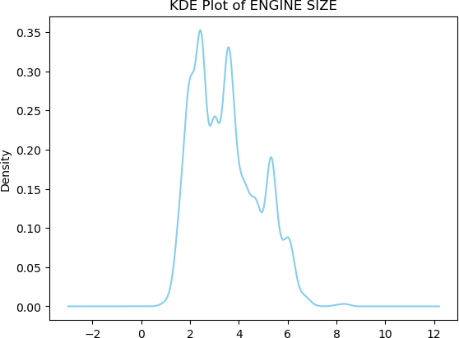
Skewness for each variables:
ENGINE SIZE: 0.5177646862321511
CYLINDERS: 0.7695704497509294
FUEL CONSUMPTION CITY (L/100KM): 0.7538204585443539 FUEL CONSUMPTION HWY (L/100KM): 0.9833163539161215
FUEL CONSUMPTION COMB (L/100KM): 0.8264945478072476 FUEL CONSUMPTION COMB (MPG): 1.1777997191723135
CO2 EMISSIONS (G/KM): 0.5001431736610606
In [22]:
# Creating plot to understand outliers for needed columns as df_cars.describe() #shows big diffrence in mean value, min value and max value.
for i in ['ENGINE SIZE','CYLINDERS','FUEL CONSUMPTION CITY (L/100KM)','FUEL CONSUMPTION HWY (L/100KM)','FUEL
df_cars.plot(kind='kde', y=i, color='skyblue', title='KDE Plot of' + ' ' + i, legend=False)

Slide 26
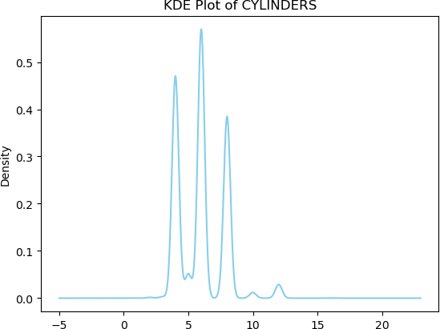

Slide 27
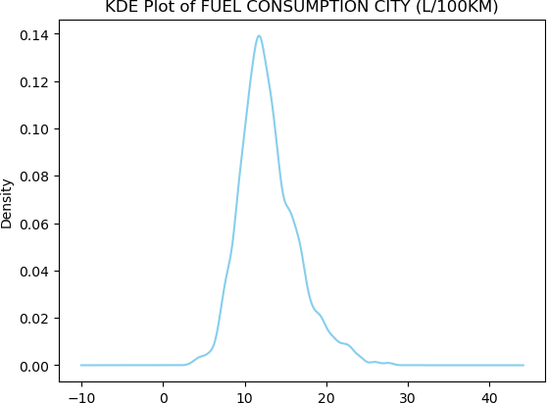

Slide 28
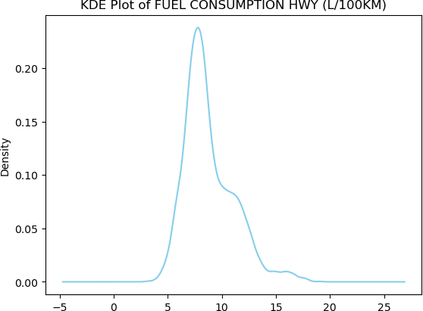

Slide 29
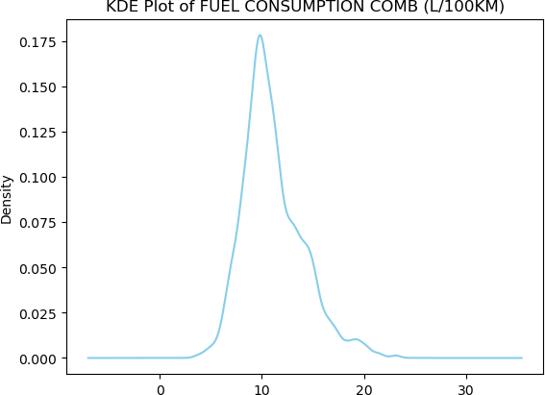

Slide 30
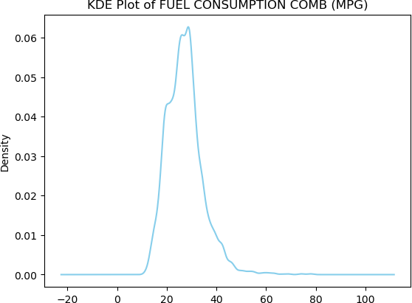

Slide 31
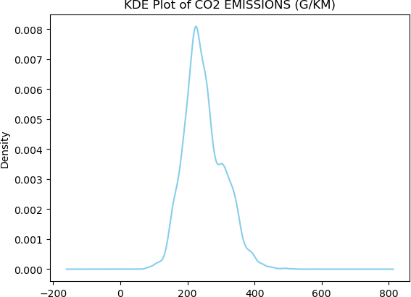
In [23]:
# Creating plot to understand outliers for needed columns as df_cars.describe() #shows big diffrence in mean value, min value and max value.
for i in ['ENGINE SIZE','CYLINDERS','FUEL CONSUMPTION CITY (L/100KM)','FUEL CONSUMPTION HWY (L/100KM)','FUEL
df_cars.plot(kind='box', y=i, title='Boxplot for ' + i)

Slide 32
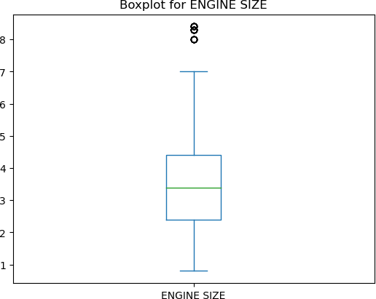

Slide 33
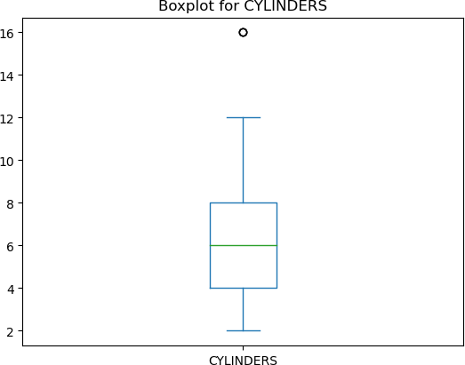

Slide 34
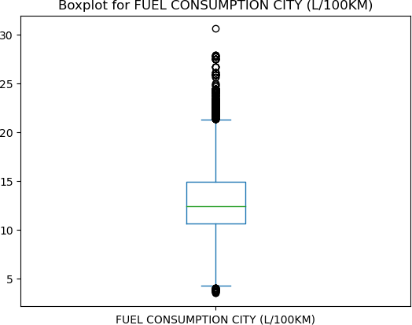

Slide 35
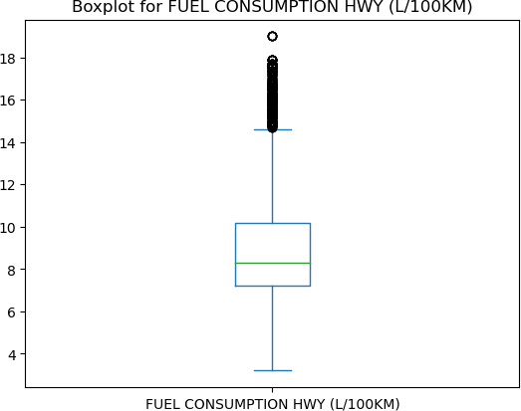

Slide 36
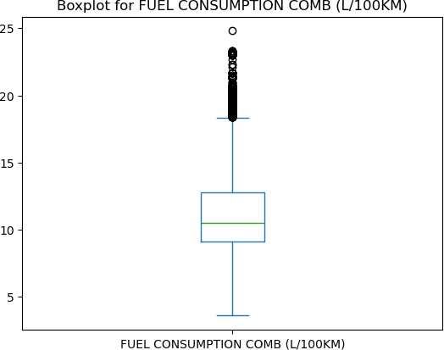

Slide 37
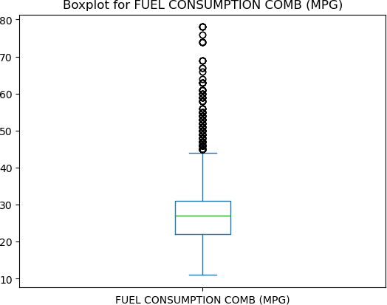

Slide 38
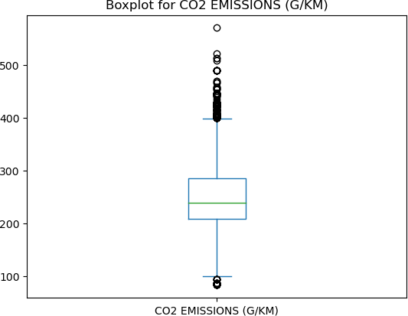
We will keep the outliers to analyze the impact of high-performance vehicles on CO2 emissions
Normal distribution
In [6]:
from sklearn import metrics
import scipy.stats as stats
In [7]:
# Analysing the normalization
# Creation of a histogram and a normality test for each variable
df_cars_numeric = df_cars.select_dtypes(include=np.number) # we remove non numeric variables
for column in df_cars_numeric.columns[:-1]: plt.figure(figsize=(8, 6)) sns.histplot(data=df_cars_numeric, x=column, kde=True)

Slide 39
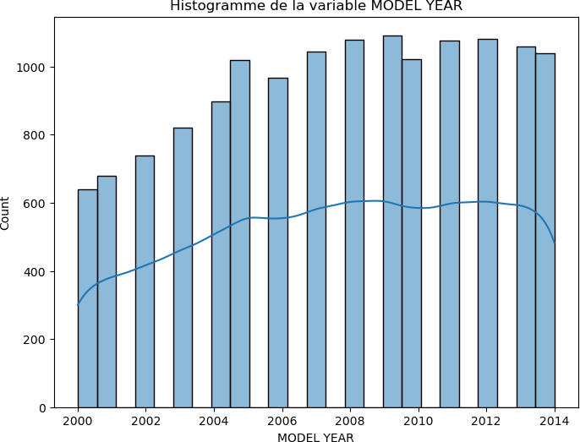
plt.title(f"Histogramme de la variable {column}") plt.show()
statistic, p_value = stats.normaltest(df_cars_numeric[column])
if p_value < 0.05:
print(f"THE VARIABLE {column} DOESN'T FOLLOW THE NORMAL DISTRIBUTION LAW (p-value={p_value})")
else:
print(f"The variable {column} FOLLOW THE NORMAL DISTRIBUTION LAW (p-value={p_value})")
THE VARIABLE MODEL YEAR DOESN'T FOLLOW THE NORMAL DISTRIBUTION LAW (p-value=0.0)

Slide 40
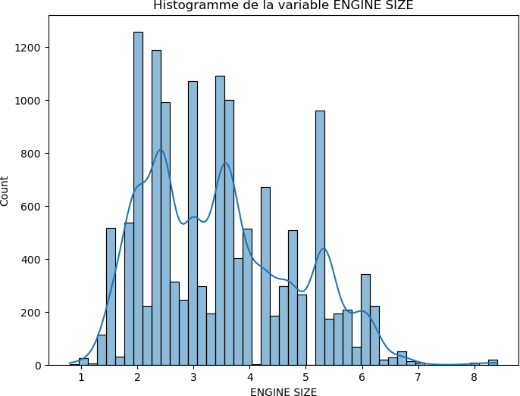
THE VARIABLE ENGINE SIZE DOESN'T FOLLOW THE NORMAL DISTRIBUTION LAW (p-value=4.374415431717652e-188)

Slide 41
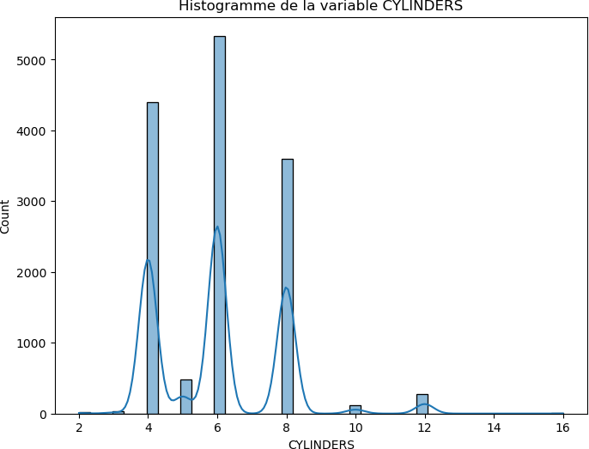
THE VARIABLE CYLINDERS DOESN'T FOLLOW THE NORMAL DISTRIBUTION LAW (p-value=2.6351150568974573e-293)

Slide 42
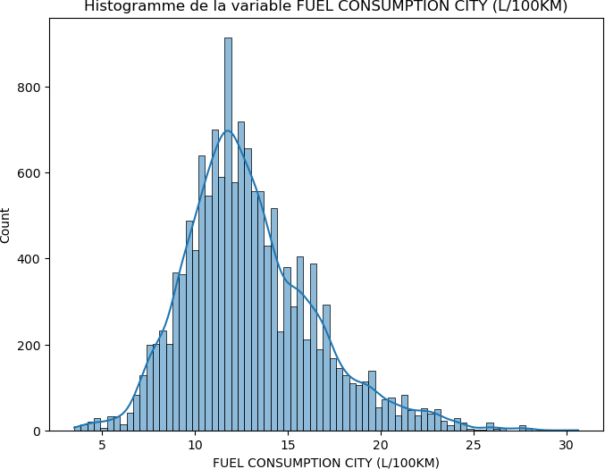
THE VARIABLE FUEL CONSUMPTION CITY (L/100KM) DOESN'T FOLLOW THE NORMAL DISTRIBUTION LAW (p-value=2.7735681340 36265e-291)

Slide 43
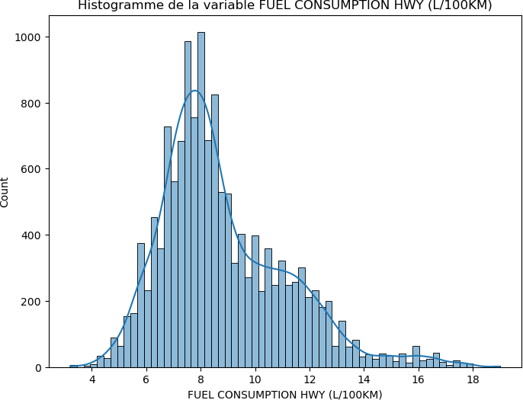
THE VARIABLE FUEL CONSUMPTION HWY (L/100KM) DOESN'T FOLLOW THE NORMAL DISTRIBUTION LAW (p-value=0.0)

Slide 44
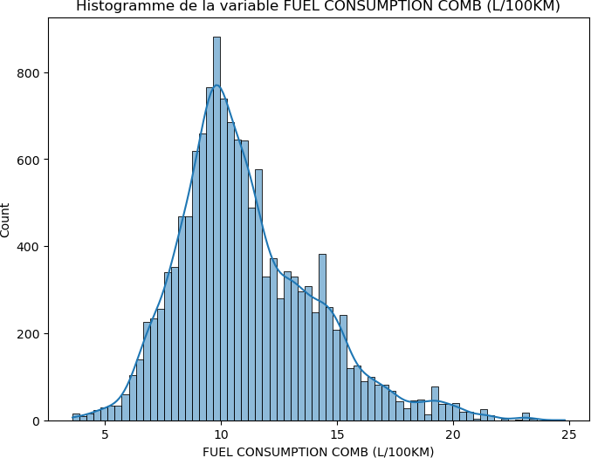
THE VARIABLE FUEL CONSUMPTION COMB (L/100KM) DOESN'T FOLLOW THE NORMAL DISTRIBUTION LAW (p-value=0.0)

Slide 45
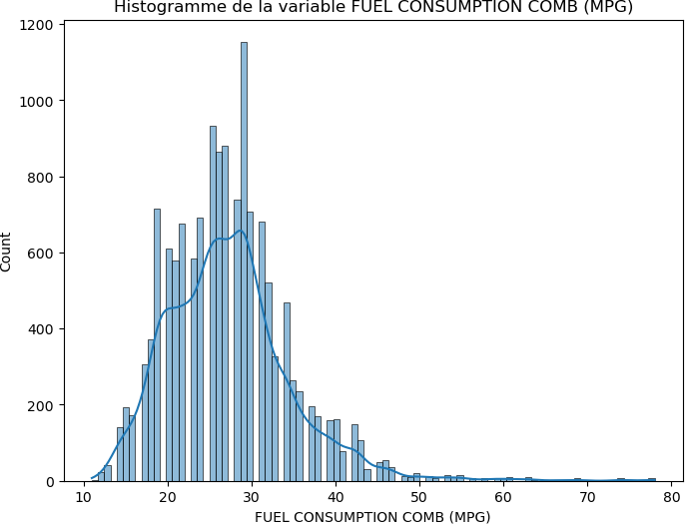
THE VARIABLE FUEL CONSUMPTION COMB (MPG) DOESN'T FOLLOW THE NORMAL DISTRIBUTION LAW (p-value=0.0)
In [8]:
#Import Seanor as sns
import seaborn as sns
Analysis
According to Ageco Uk:

Slide 46
"If you want to understand what is considered high or low in terms of petrol/diesel/hybrid emissions, here is a rough guide:
*150g/km is considered low
*160 to 255g/km is considered medium
*Above 255g/km is considered high "
https://www.ageco.co.uk/useful-articles/car/what-are-the-co2-emissions-of-my- car/#:~:text=If%20you%20want%20to%20understand,255g%2Fkm%20is%20considered%20high
I- 5 top classes of engine that we should stop to produce
In [9]:
# Engines which produce more than 255G/KM CO2
harmful_engines = df_cars[df_cars['CO2 EMISSIONS (G/KM)']>255] harmful_engines.head()
Out[9]:
FUEL FUEL
 | MODEL YEAR | MAKE | MODEL | VEHICLE CLASS | ENGINE SIZE | CYLINDERS | TRANSMISSION | FUEL TYPE | CONSUMPTION CITY (L/100KM) | CONSUMPTION HWY (L/100KM) | CONSU (L/
3 | 2000 | ACURA | 3.5RL | MID-SIZE | 3.5 | 6 | A4 | Z | 13.4 | 9.2
7 | 2000 | ACURA | NSX | SUBCOMPACT | 3.0 | 6 | AS4 | Z | 13.6 | 9.2
8 | 2000 | ACURA | NSX | SUBCOMPACT | 3.2 | 6 | M6 | Z | 13.8 | 9.1
17 | 2000 | AUDI | A6 | MID-SIZE | 2.8 | 6 | A5 | Z | 13.4 | 8.6
18 | 2000 | AUDI | A6 AVANT | STATION WAGON - | 2.8 | 6 | A5 | Z | 13.8 | 9.1
 |  |  | QUATTRO | MID-SIZE
In [10]:
#Describes statistics of harmful engines
harmful_engines.describe()

Slide 47
Interpretation of the stastistical metrics of harmful engines
Out[10]:
 | MODEL YEAR | ENGINE SIZE | CYLINDERS | FUEL CONSUMPTION CITY (L/100KM) | FUEL CONSUMPTION HWY (L/100KM) | FUEL CONSUMPTION COMB (L/100KM) | FUEL CONSUMPTION COMB (MPG) | CO2 EMISSIONS (G/KM)
count | 5560.000000 | 5560.000000 | 5560.000000 | 5560.000000 | 5560.000000 | 5560.000000 | 5560.000000 | 5560.000000
mean | 2006.936331 | 4.665288 | 7.487770 | 16.230863 | 11.046277 | 13.900881 | 20.840468 | 308.330935
std | 3.999538 | 1.004371 | 1.532121 | 2.795339 | 1.953902 | 2.359048 | 3.136445 | 40.043961
min | 2000.000000 | 1.300000 | 2.000000 | 10.900000 | 7.700000 | 9.600000 | 11.000000 | 256.000000
25% | 2004.000000 | 4.000000 | 6.000000 | 14.100000 | 9.500000 | 12.000000 | 19.000000 | 276.000000
50% | 2007.000000 | 4.700000 | 8.000000 | 15.600000 | 10.700000 | 13.400000 | 21.000000 | 301.000000
75% | 2010.000000 | 5.300000 | 8.000000 | 17.400000 | 12.000000 | 15.000000 | 24.000000 | 334.000000
max | 2014.000000 | 8.400000 | 16.000000 | 30.600000 | 19.000000 | 24.800000 | 29.000000 | 570.000000
50 % of harmful engines have:Engine size less than or equal to 4.7, Cylinders less than or equal to 8.0 and realease less than or equal to 301 (G/KM) CO2 in the air.
The average CO2 emissions of the harmful engines is 308.32 G/KM
75% of harmful engines have : Engine size less than or equal to 5.3, Cylinders size less than or equal to 8.0 and release less than or equal to 334 G/KM CO2 to the air.
The most harmful engines have Engine size equal to 8.4, Cylinder size of 16.0 and release 570 G/KM in the air.
In [11]:
#5 top classes of engine that we should stop to produce
harmful_classes = df_cars['VEHICLE CLASS'][df_cars['CO2 EMISSIONS (G/KM)']>255].value_counts() print("Top 5 Harmful Classes are :\n" + str(harmful_classes.head(5)))

Slide 48
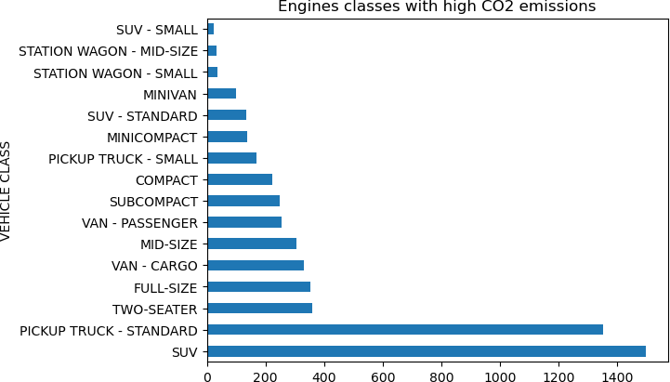
Top 5 Harmful Classes are : VEHICLE CLASS
SUV | 1498
PICKUP TRUCK - STANDARD | 1352
TWO-SEATER | 358
FULL-SIZE | 354
VAN - CARGO Name: count, dtype: int64 | 332
In [12]:
# Visualization of the Harmful classes
harmful_classes.plot(y='VEHICLE CLASS', kind='barh', title='Engines classes with high CO2 emissions')
plt.show()
Interpretation
We can see a huge differences between the differents classes of engine and the 5 top harmfull classes are :

Slide 49
SUV
PICKUP TRUCK - STANDARD
TWO-SEATER
FULL-SIZE
VAN - CARGO
II - 5 top brands which produce engines with less CO2 and can be recommended to the public
In [32]:
# Engines which produce less than or equal to 150G/KM CO2
eco_engines = df_cars[df_cars['CO2 EMISSIONS (G/KM)']<=150] eco_engines.head()
Out[32]:
FUEL FUEL
 | MODEL YEAR | MAKE | MODEL | VEHICLE CLASS | ENGINE SIZE | CYLINDERS | TRANSMISSION | FUEL TYPE | CONSUMPTION CITY | CONSUMPTION CO HWY
 |  |  |  |  |  |  |  |  | (L/100KM) | (L/100KM)
114 | 2000 | CHEVROLET | METRO | SUBCOMPACT | 1.0 | 3.0 | M5 | X | 6.0 | 4.5
116 | 2000 | CHEVROLET | METRO | SUBCOMPACT | 1.3 | 4.0 | M5 | X | 6.4 | 4.9
328 | 2000 | HONDA | INSIGHT | SUBCOMPACT | 1.0 | 3.0 | M5 | X | 3.9 | 3.2
467 | 2000 | PONTIAC | FIREFLY | SUBCOMPACT | 1.0 | 3.0 | M5 | X | 6.0 | 4.5
469 | 2000 | PONTIAC | FIREFLY | SUBCOMPACT | 1.3 | 4.0 | M5 | X | 6.4 | 4.9
In [33]:
# Statisticals summary of ecological engines which relaase less than or equal 150G/KM
eco_engines.describe()

Slide 50
Interpretation of the stastistical metrics
Out[33]:
 | MODEL YEAR | ENGINE SIZE | CYLINDERS | FUEL CONSUMPTION CITY (L/100KM) | FUEL CONSUMPTION HWY (L/100KM) | FUEL CONSUMPTION COMB (L/100KM) | FUEL CONSUMPTION COMB (MPG) | CO2 EMISSIONS (G/KM) | CONSU CIT
count | 383.000000 | 383.000000 | 383.000000 | 383.000000 | 383.000000 | 383.000000 | 383.000000 | 383.000000 | 383
mean | 2010.516971 | 1.707833 | 3.947781 | 6.322715 | 5.082507 | 5.764491 | 50.203655 | 132.629243 | 46
std | 3.912538 | 0.434375 | 0.335335 | 1.243467 | 0.618673 | 0.899850 | 8.722618 | 17.761903 | 10
min | 2000.000000 | 0.800000 | 3.000000 | 3.500000 | 3.200000 | 3.600000 | 31.000000 | 83.000000 | 26
25% | 2009.000000 | 1.500000 | 4.000000 | 5.600000 | 4.800000 | 5.200000 | 45.000000 | 122.000000 | 3
50% | 2012.000000 | 1.600000 | 4.000000 | 6.800000 | 5.100000 | 6.000000 | 47.000000 | 140.000000 | 4
75% | 2013.000000 | 1.900000 | 4.000000 | 7.100000 | 5.400000 | 6.300000 | 54.000000 | 145.000000 | 50
max | 2014.000000 | 3.500000 | 6.000000 | 10.500000 | 7.500000 | 9.100000 | 78.000000 | 150.000000 | 8
50 % of harmful engines have:Engine size less than or equal to 1.6, Cylinders less than or equal to 4.0 and realease less than or equal to 140 (G/KM) CO2 in the air.
The average CO2 emissions of the harmful engines is 132.629 G/KM
75% of harmful engines have : Engine size less than or equal to 1.9, Cylinders size less than or equal to 4.0 and release less than or equal to 145 G/KM CO2 to the air.
Engines which release very little CO2 in the air have: an engine size of 0.8, a cylinder equal to 3.0, consume 3.5l/100KM fuel in City and 3.2 L/100KM in highway. With a CO2 emissions of 83 G/KM. This type of engine are the most ecological engines, and should be recommend to consumers.
In [34]:
#Brands which produce engines with less CO2
eco_brands = df_cars['MAKE'][df_cars['CO2 EMISSIONS (G/KM)']<=150].value_counts() print("Ecological Brands are:\n" + str(eco_brands))

Slide 51
Ecological MAKE | Brands | are:
TOYOTA | 74
HONDA | 60
FORD | 40
MAZDA | 26
HYUNDAI | 26
MINI | 24
VOLKSWAGEN | 23
CHEVROLET | 19
SMART | 17
KIA | 16
NISSAN | 14
LEXUS | 11
FIAT | 9
DODGE | 6
LINCOLN | 4
SCION | 3
SUZUKI | 2
PONTIAC | 2
ACURA | 2
INFINITI | 2
MITSUBISHI | 2
SUBARU | 1
Name: count, dtype: int64
In [35]:
# Visualization of Brands which produce engines with less CO2
eco_brands.plot(y='MAKE', kind='bar', title='Brands engines with less CO2 emissions') plt.show()

Slide 52
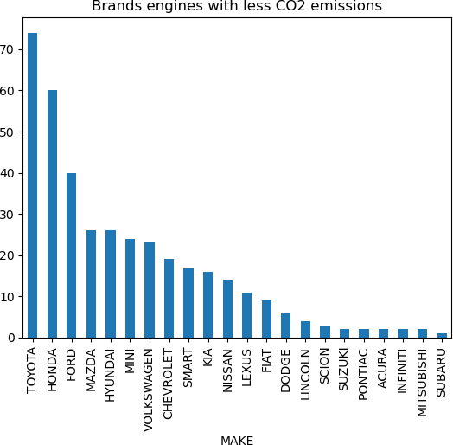
In [36]:
#Top 5 ecological brands
eco_brands.head(5)
Out[36]:
MAKE TOYOTA HONDA FORD MAZDA HYUNDAI
74
60
40
26
26
Name: count, dtype: int64

Slide 53
Interpretation
The top 5 ecological brands which release less CO2 are: TOYOTA, HONDA, FORD, MAZDA, HYUNDAI
III- Transmission which produces less CO2
In [37]:
#Filter of the data set in transmission's engines with low CO2 emission
eco_Transmissions = df_cars['TRANSMISSION'][df_cars['CO2 EMISSIONS (G/KM)']<=150].value_counts() print("Ecological Transmissions are:\n" + str(eco_Transmissions))
Ecological Transmissions are: TRANSMISSION
M5 | 102
AV | 96
M6 | 58
AS6 | 41
A6 | 27
A4 | 18
AS5 | 10
A5 | 8
AM6 | 6
AV7 | 6
AM5 | 4
AS7 | 3
AM7 | 2
AV6 | 1
AV8 Name: | 1 count, | dtype: int64
In [38]:
# Visualization of Transmission which produces less CO2
eco_Transmissions.plot(y='MAKE', kind='bar', title='Transmission for engines with low CO2 emissions') plt.show()

Slide 54
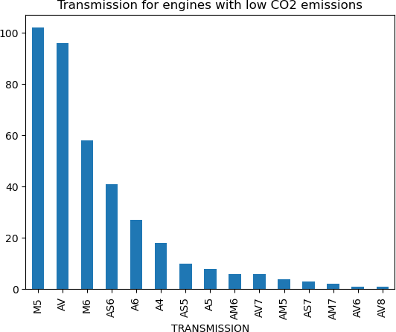
Interpretation
The transmissions which produce less CO2 are :
AV8 AV6 AM7
IV- 3 top ecological model engines which produce the lowest Co2 produce between 2010 and 2014

Slide 55
In [33]:
#Subset for the period from 2010 to 2014
df_cars_2010_2014 = df_cars[(df_cars["MODEL YEAR"] >= 2010) & (df_cars["MODEL YEAR"] <= 2014)] df_cars_2010_2014.head(3)
Out[33]:
MODEL
VEHICLE ENGINE
FUEL
FUEL CONSUMPTION
FUEL CONSUMPTION
F CONSUMPT
 | YEAR | MAKE | MODEL | CLASS | SIZE | CYLINDERS | TRANSMISSION | TYPE | CITY | HWY | C
 |  |  |  |  |  |  |  |  | (L/100KM) | (L/100KM) | (L/100
8977 | 2010 | ACURA | CSX | COMPACT | 2.0 | 4.0 | AS5 | X | 9.5 | 6.5
8978 | 2010 | ACURA | CSX | COMPACT | 2.0 | 4.0 | M5 | X | 8.7 | 6.4
8979 | 2010 | ACURA | CSX | COMPACT | 2.0 | 4.0 | M6 | Z | 10.2 | 6.8
In [34]:
# Ecological model engine from 2010 to 2014 with less or equal 150 G/KM Co2 emissions
df_cars_eco_type_2010_2014 = df_cars_2010_2014['MODEL'][df_cars_2010_2014['CO2 EMISSIONS (G/KM)']<=150].value print("Model with less CO2 emission from 2010 to 2014:\n" + str(df_cars_eco_type_2010_2014))
Model with less CO2 emission from 2010 to 2014: MODEL
YARIS FIT CIVIC
FOCUS FFV FIESTA
10
10
9
8
8
..
1
1
1
1
1
500 ABARTH CABRIO INSIGHT DX/LX COOPER COUNTRYMAN 500
COROLLA LE ECO (2-mode)
Name: count, Length: 85, dtype: int64
In [35]:
#Visualization of the ecological model engines from 2010 to 2014 with less or equal 150 G/KM Co2 emissions
df_cars_eco_type_2010_2014.plot(y ='MODEL', kind='bar', width=1, edgecolor='white', color="red",

Slide 56
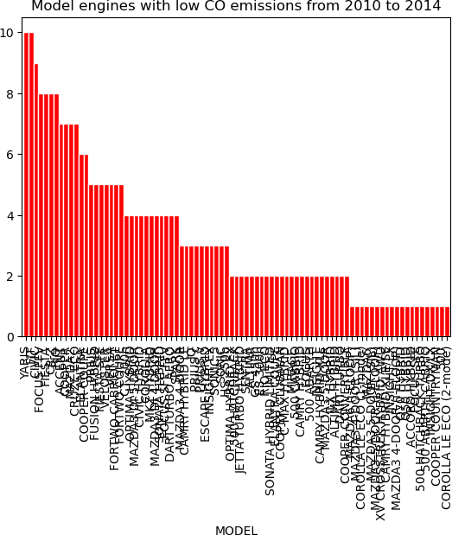
title='Model engines with low CO emissions from 2010 to 2014' )
plt.show()
In [36]:
# Top 3 ecological model engines which produce the lowest Co2 produce between 2010 and 2014
df_cars_eco_type_2010_2014.head(3)

Slide 57
Out[36]:
MODEL YARIS FIT CIVIC
10
10
9
Name: count, dtype: int64
Interpretation
The top 3 ecological model engines are YARIS, FIT and CIVIC
V- Does that size of the engine play a determinant role on the CO2 emissions amount
In [37]:
engine_size = df_cars['ENGINE SIZE'][df_cars['CO2 EMISSIONS (G/KM)']>255 ].value_counts()
print("Engine sizes are:\n" + str(engine_size))

Slide 58
Engine ENGINE | sizes SIZE | are:
5.3 | 858
4.0 | 375
4.3 | 308
4.2 | 282
6.0 | 264
4.7 | 254
4.6 | 245
4.8 | 224
5.0 | 222
3.5 | 217
6.2 | 205
3.7 | 182
5.4 | 174
5.7 | 171
3.0 | 167
3.6 | 151
5.5 | 137
4.4 | 121
3.8 | 114
3.2 | 102
5.2 | 73
3.3 | 69
5.9 | 68
2.7 | 60
3.9 | 58
2.8 | 56
6.7 | 50
5.6 | 50
3.4 | 49
2.5 | 45
4.5 | 28
6.1 | 23
6.5 | 19
6.4 | 17
6.8 | 14
2.9 | 13
1.3 | 12
8.4 | 10
8.3 | 10
6.6 | 9
8.0 | 9
7.0 | 8
2.4 | 8

Slide 59
4.9 | 8
5.8 | 6
2.0 | 5
2.6 | 3
2.3 | 3
4.1 | 1
3.1 | 1
6.3 | 1
Name: | count, dtype: int64
In [38]:
# Import the ols function
from statsmodels.formula.api import ols
mdl_engine = df_cars["ENGINE SIZE"] co2 = df_cars["CO2 EMISSIONS (G/KM)"]
# Create the model object
mdl_engine_vs_co2 = ols("mdl_engine~co2", data=df_cars)
# Fit the model
mdl_engine_vs_co2 = mdl_engine_vs_co2.fit()
# Print the parameters of the fitted model
print(mdl_engine_vs_co2.params)
Intercept co2
-1.081761
0.018328
dtype: float64
In [41]:
#Visualization of the correlation between Engine Size and CO2 consumption
x = df_cars['ENGINE SIZE']
y = df_cars['CO2 EMISSIONS (G/KM)']
sns.set(style='whitegrid')
sns.scatterplot(x= 'ENGINE SIZE', y= 'CO2 EMISSIONS (G/KM)', data= df_cars, hue='CO2 EMISSIONS (G/KM)')
Out[41]:
<Axes: xlabel='ENGINE SIZE', ylabel='CO2 EMISSIONS (G/KM)'>

Slide 60
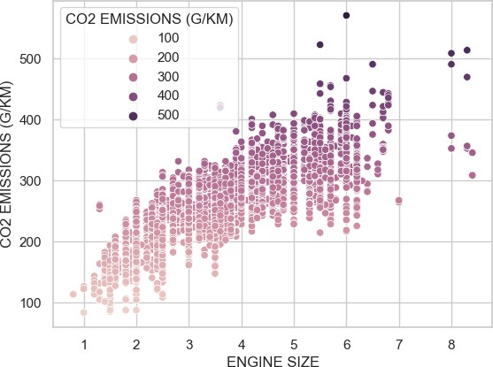
Interpretation:
Darker points represent larger CO2 values and they tend to higher engine size.
There is a positive correlation between the Engine Size and the CO2 emissions. As we can see, the larger the size of the machine, the greater the CO2 consumption. For example, when a vehicle has a size of around 8, its CO2 emission is between 400 to 500 G/KM.
K-means Cluster Analysis
Assumptions for k-means:

Slide 61
Symmetric distribution of variables (not skewed) Variables have same average values
Variables have same variance
In [14]:
# Scale and normalize data
df_cars_vars = df_cars[['CO2 EMISSIONS (G/KM)', 'FUEL CONSUMPTION CITY (L/100KM)', 'FUEL CONSUMPTION HWY (L/1
df_cars_vars_log = np.log(df_cars_vars) #log the data to remove skewness
scaler = StandardScaler() #scale data to standardize variables
scaler.fit(df_cars_vars_log)
df_cars_scaled = scaler.transform(df_cars_vars_log)
In [15]:
# Determine optimal number of clusters using Elbow method (select number with the strongest angle)
sse = {}
K = range(1, 11)
for k in K:
kmeans = KMeans(n_clusters=k, random_state=1)
kmeans.fit(df_cars_scaled) sse[k] = kmeans.inertia_
# Plot SSE for each k
plt.title('Elbow Method') plt.xlabel('k') plt.ylabel('SSE')
sns.pointplot(x=list(sse.keys()), y=list(sse.values())) plt.show()
#strongest angle is k=3

Slide 62

In [84]:
#fitting the K-means model on the scaled dataset
kmeans = KMeans(n_clusters=3, random_state=1) kmeans.fit(df_cars_scaled)
cluster_labels = kmeans.labels_
In [85]:
#some base descriptive analysis on means from the clusters
df_cars_k3 = df_cars.assign(Cluster = cluster_labels) df_cars_k3.groupby(['Cluster']).agg({
'ENGINE SIZE': 'mean',
'FUEL CONSUMPTION CITY (L/100KM)': 'mean', 'FUEL CONSUMPTION HWY (L/100KM)': 'mean', 'FUEL CONSUMPTION COMB (L/100KM)': 'mean',

Slide 63
'FUEL CONSUMPTION COMB (MPG)': 'mean', 'CO2 EMISSIONS (G/KM)': ['mean', 'count'],
}).round(1)
Out[85]:
ENGINE
SIZE
FUEL CONSUMPTION CITY (L/100KM)
FUEL CONSUMPTION HWY (L/100KM)
FUEL CONSUMPTION COMB (L/100KM)
FUEL CONSUMPTION CO2 EMISSIONS COMB (MPG) (G/KM)
Cluster | mean | mean | mean | mean | mean | mean | count
0 | 4.9 | 17.2 | 11.8 | 14.7 | 19.5 | 320.1 | 4248
1 | 3.2 | 12.1 | 8.1 | 10.3 | 27.5 | 236.4 | 7110
2 | 2.0 | 8.7 | 6.2 | 7.6 | 38.1 | 174.6 | 2894
In [75]:
cluster_brand_count = df_cars_k3.groupby(['Cluster', 'MAKE']).size() cluster_class_count = df_cars_k3.groupby(['Cluster', 'VEHICLE CLASS']).size() cluster_fuel_count = df_cars_k3.groupby(['Cluster', 'FUEL TYPE']).size() cluster_engine_count = df_cars_k3.groupby(['Cluster', 'ENGINE SIZE']).size()
majority_brands = cluster_brand_count.groupby(level=0).idxmax().apply(lambda x: x[1]) majority_class = cluster_class_count.groupby(level=0).idxmax().apply(lambda x: x[1]) majority_fuel = cluster_fuel_count.groupby(level=0).idxmax().apply(lambda x: x[1]) majority_engine = cluster_engine_count.groupby(level=0).idxmax().apply(lambda x: x[1])
# Displaying the majority brand for each cluster print("Majority Brand for Each Cluster:") print(majority_brands)
print()
print("Majority Class for Each Cluster:") print(majority_class)
print()
print("Majority Fuel Type for Each Cluster:") print(majority_fuel)
print()
print("Majority Engine Size for Each Cluster:") print(majority_engine)

Slide 64
Majority Brand for Each Cluster: Cluster
0
1
2
CHEVROLET
BMW VOLKSWAGEN
dtype: object
Majority Class for Each Cluster: Cluster
0
1
2
SUV SUV COMPACT
dtype: object
Majority Fuel Type for Each Cluster: Cluster
0
1
2
X X X
dtype: object
Majority Engine Size for Each Cluster: Cluster
0
1
2
5.3
3.0
2.0
dtype: float64
In [79]:
#plotting boxplots for each variable containing comparisons of each cluster
feature_list = ['ENGINE SIZE', 'CYLINDERS','FUEL CONSUMPTION CITY (L/100KM)',
'FUEL CONSUMPTION HWY (L/100KM)', 'FUEL CONSUMPTION COMB (L/100KM)', 'FUEL CONSUMPTION COMB (MPG)']
for i in feature_list:
df_cars_k3.boxplot(column=i, by='Cluster', figsize=(8,6)) plt.title('Boxplot of ' + i + ' by Cluster') plt.xlabel('Cluster Number')
plt.ylabel(i) plt.show()

Slide 65
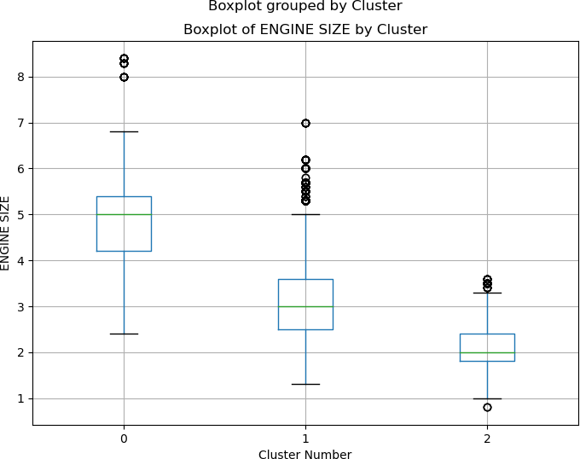

Slide 66
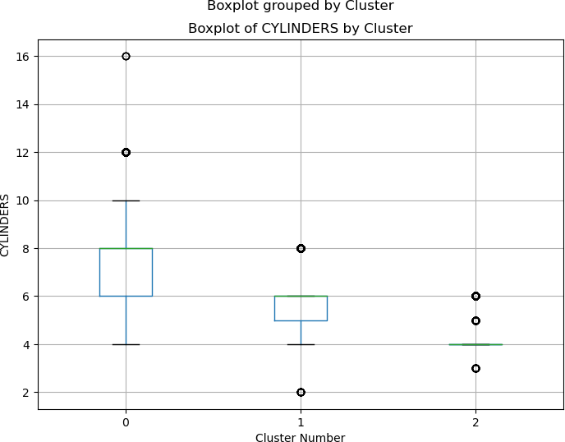

Slide 67
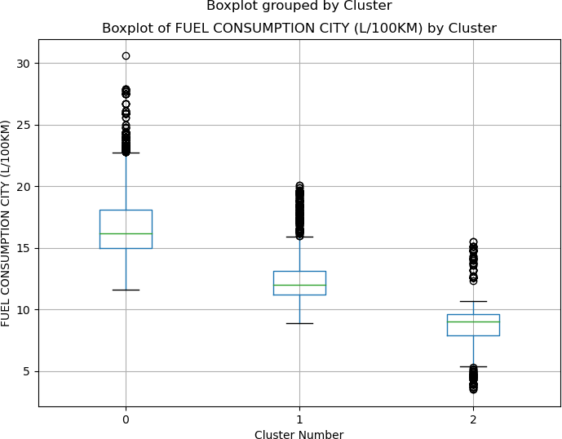

Slide 68
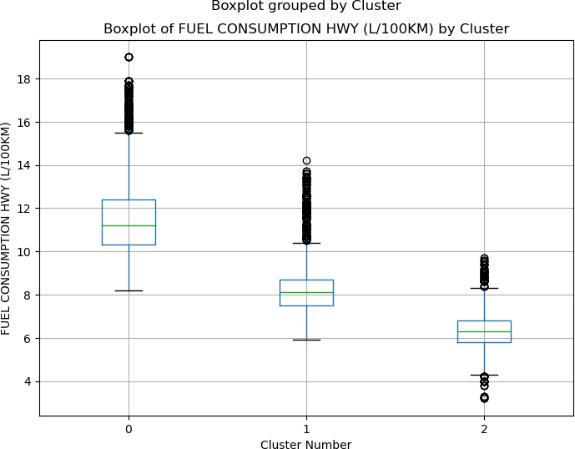

Slide 69
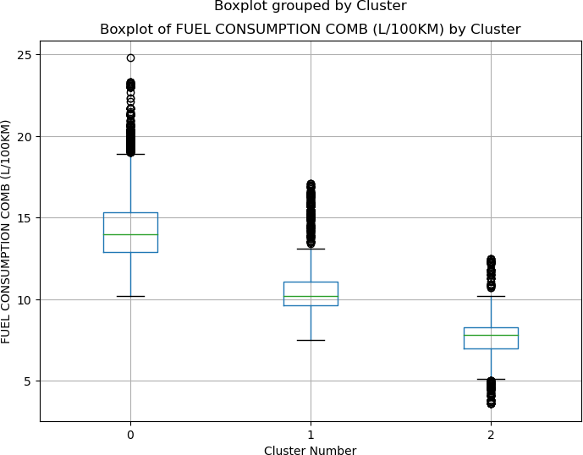

Slide 70
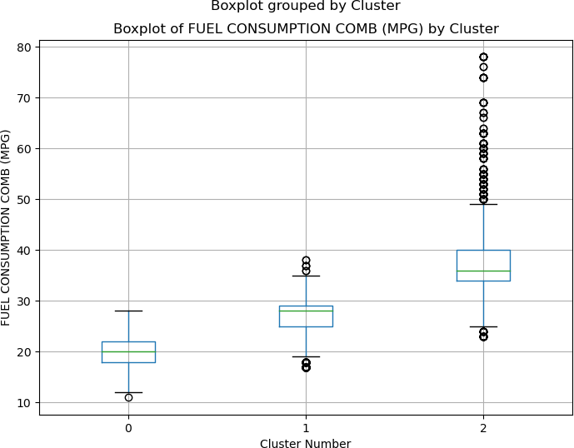
In [81]:
#plotting correlation matrix to demonstrate correlation between variables for each cluster
for i in range(3):
cluster_data = df_cars_k3[df_cars_k3['Cluster'] == i] cluster_corr = cluster_data.corr(numeric_only = True)
mask = np.triu(np.ones_like(cluster_corr, dtype=bool)) #remove top half of correlation matrix for easier
plt.title(f'Correlation Heatmap for Cluster {i}')

Slide 71
row_labels = [col for col in cluster_corr.index if col != 'Cluster'] #select only rows that are not 'Clu
col_labels = [col for col in cluster_corr.columns if col != 'Cluster'] #select only columns that are not
sns.heatmap(cluster_corr, annot=True, cmap='coolwarm', fmt=".2f", mask=mask, yticklabels=row_labels, xtic plt.show()

Slide 72
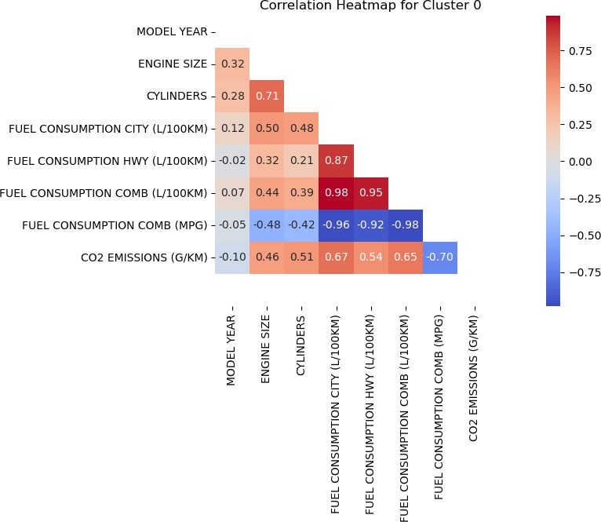

Slide 73
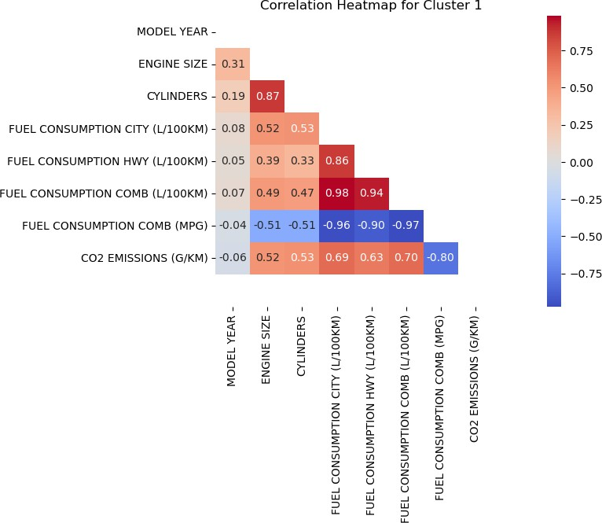

Slide 74
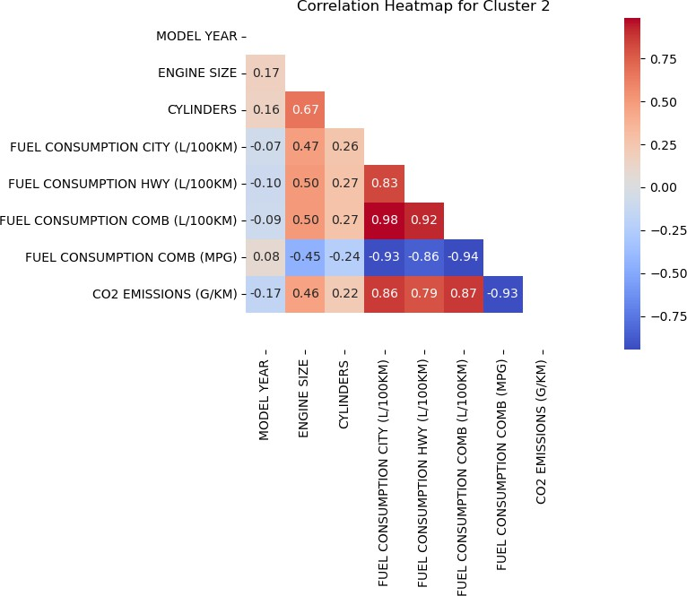
In [83]:
#calculating descriptive analytics for each cluster

Slide 75
for i in range(3):
cluster_data = df_cars_k3[df_cars_k3['Cluster'] == i]
cluster_descriptive = cluster_data.describe().transpose() print('Cluster ' + str(i) + ' Descriptive Analytics:') print(cluster_descriptive)
print()
print()

Slide 76
Cluster 0 Descriptive Analytics: |  |  |  | count | mean |  | std |  | min | \
MODEL YEAR |  |  |  | 4188.0 | 2006.891356 |  | 3.964241 |  | 2000.0
ENGINE SIZE |  |  |  | 4188.0 | 4.890019 |  | 0.916419 |  | 2.4
CYLINDERS |  |  |  | 4188.0 | 7.742359 |  | 1.529817 |  | 4.0
FUEL CONSUMPTION CITY (L/100KM) |  |  |  | 4188.0 | 16.977937 |  | 2.702215 |  | 11.6
FUEL CONSUMPTION HWY (L/100KM) |  |  |  | 4188.0 | 11.619389 |  | 1.832074 |  | 8.2
FUEL CONSUMPTION COMB (L/100KM) |  |  |  | 4188.0 | 14.571060 |  | 2.239958 |  | 10.2
FUEL CONSUMPTION COMB (MPG) |  |  |  | 4188.0 | 19.787011 |  | 2.684065 |  | 11.0
CO2 EMISSIONS (G/KM) |  |  |  | 4188.0 | 322.577603 |  | 36.032559 |  | 275.0
Cluster |  |  |  | 4188.0 | 0.000000 |  | 0.000000 |  | 0.0
 |  |  |  | 25% | 50% | 75% |  | max
MODEL YEAR |  |  |  | 2004.0 | 2007.0 | 2010.0 |  | 2014.0
ENGINE SIZE |  |  |  | 4.2 | 5.0 | 5.4 |  | 8.4
CYLINDERS |  |  |  | 6.0 | 8.0 | 8.0 |  | 16.0
FUEL CONSUMPTION |  | CITY | (L/100KM) | 15.0 | 16.2 | 18.1 |  | 30.6
FUEL | CONSUMPTION | HWY (L/100KM) |  | 10.3 | 11.2 | 12.4 |  | 19.0
FUEL | CONSUMPTION | COMB (L/100KM) |  | 12.9 | 14.0 | 15.3 |  | 24.8
FUEL | CONSUMPTION | COMB (MPG) |  | 18.0 | 20.0 | 22.0 |  | 28.0
CO2 EMISSIONS (G/KM) |  |  |  | 297.0 | 315.0 | 341.0 |  | 570.0
Cluster |  |  |  | 0.0 | 0.0 | 0.0 |  | 0.0
Cluster 1 Descriptive Analytics: |  |  | count | mean |  | std |  | min | \
MODEL YEAR |  |  | 7201.0 | 2007.343980 |  | 4.069926 |  | 2000.0
ENGINE SIZE |  |  | 7201.0 | 3.228899 |  | 0.891414 |  | 1.3
CYLINDERS |  |  | 7201.0 | 5.721844 |  | 1.231635 |  | 2.0
FUEL CONSUMPTION CITY (L/100KM) |  |  | 7201.0 | 12.257284 |  | 1.634020 |  | 8.9
FUEL CONSUMPTION HWY (L/100KM) |  |  | 7201.0 | 8.225788 |  | 1.058731 |  | 5.9
FUEL CONSUMPTION COMB (L/100KM) |  |  | 7201.0 | 10.443175 |  | 1.329750 |  | 7.5
FUEL CONSUMPTION COMB (MPG) |  |  | 7201.0 | 27.397723 |  | 2.966876 |  | 17.0
CO2 EMISSIONS (G/KM) |  |  | 7201.0 | 235.639217 |  | 19.875329 |  | 202.0
Cluster |  |  | 7201.0 | 1.000000 |  | 0.000000 |  | 1.0
 |  |  | 25% | 50% | 75% |  | max
MODEL YEAR |  |  | 2004.0 | 2007.0 | 2011.0 |  | 2014.0
ENGINE SIZE |  |  | 2.5 | 3.0 | 3.6 |  | 7.0
CYLINDERS |  |  | 5.0 | 6.0 | 6.0 |  | 8.0
FUEL CONSUMPTION | CITY | (L/100KM) | 11.2 | 12.0 | 13.1 |  | 20.1
FUEL CONSUMPTION | HWY (L/100KM) |  | 7.5 | 8.1 | 8.7 |  | 14.2
FUEL CONSUMPTION | COMB (L/100KM) |  | 9.6 | 10.2 | 11.1 |  | 17.1
FUEL CONSUMPTION | COMB (MPG) |  | 25.0 | 28.0 | 29.0 |  | 38.0
CO2 EMISSIONS (G/KM) |  | 218.0 |  | 235.0 | 253.0 |  | 274.0

Slide 77
Cluster |  |  |  |  | 1.0 | 1.0 |  | 1.0 | 1.0
Cluster 2 Descriptive Analytics: |  |  |  |  | count | mean |  |  | std | min | \
MODEL YEAR |  |  |  |  | 2864.0 | 2009.239525 |  |  | 4.098750 | 2000.0
ENGINE SIZE |  |  |  |  | 2864.0 | 2.038792 |  |  | 0.431189 | 0.8
CYLINDERS |  |  |  |  | 2864.0 | 4.107891 |  |  | 0.463725 | 3.0
FUEL CONSUMPTION CITY (L/100KM) |  |  |  |  | 2864.0 | 8.724337 |  |  | 1.496139 | 3.5
FUEL CONSUMPTION HWY (L/100KM) |  |  |  |  | 2864.0 | 6.276990 |  |  | 0.816879 | 3.2
FUEL CONSUMPTION COMB (L/100KM) |  |  |  |  | 2864.0 | 7.624197 |  |  | 1.147339 | 3.6
FUEL CONSUMPTION COMB (MPG) |  |  |  |  | 2864.0 | 37.968925 |  |  | 6.736346 | 23.0
CO2 EMISSIONS |  | (G/KM) |  |  | 2864.0 | 173.957053 |  | 21.915165 |  | 83.0
Cluster |  |  |  |  | 2864.0 | 2.000000 |  | 0.000000 |  | 2.0
 |  |  |  |  | 25% | 50% | 75% |  | max
MODEL YEAR |  |  |  |  | 2006.0 | 2010.0 | 2013.0 |  | 2014.0
ENGINE SIZE |  |  |  |  | 1.8 | 2.0 | 2.4 |  | 3.6
CYLINDERS |  |  |  |  | 4.0 | 4.0 | 4.0 |  | 6.0
FUEL CONSUMPTION |  |  | CITY | (L/100KM) | 7.9 | 9.0 | 9.6 |  | 15.5
FUEL | CONSUMPTION |  | HWY (L/100KM) |  | 5.8 | 6.3 | 6.8 |  | 9.7
FUEL | CONSUMPTION |  | COMB (L/100KM) |  | 7.0 | 7.8 | 8.3 |  | 12.5
FUEL | CONSUMPTION |  | COMB (MPG) |  | 34.0 | 36.0 | 40.0 |  | 78.0
CO2 EMISSIONS (G/KM) |  |  |  | 161.0 |  | 179.0 | 191.0 |  | 200.0
Cluster |  |  |  | 2.0 |  | 2.0 | 2.0 |  | 2.0
In [88]:
# Define colors for each cluster
cluster_colors = {0: 'blue', 1: 'green', 2: 'red'}
# Plotting the scatterplot
plt.figure(figsize=(10, 8))
for cluster, color in cluster_colors.items():
cluster_data = df_cars_k3[df_cars_k3['Cluster'] == cluster]
plt.scatter(cluster_data['ENGINE SIZE'], cluster_data['CYLINDERS'], label=f'Cluster {cluster}', c=color)
plt.title('Clusters Visualization: Engine Size vs Fuel Type vs CO2 Emissions') plt.xlabel('Engine Size')
plt.ylabel('CYLINDERS') plt.legend() plt.grid(True) plt.show()

Slide 78
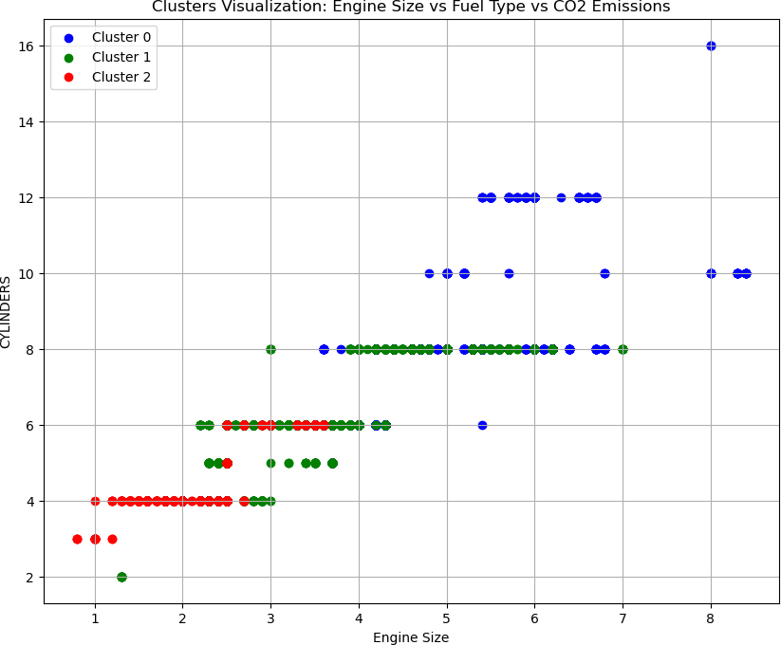

Slide 79
In [91]:
# Define colors for each cluster
cluster_colors = {0: 'blue', 1: 'green', 2: 'red'}
# Plotting the scatterplot
plt.figure(figsize=(10, 8))
for cluster, color in cluster_colors.items():
cluster_data = df_cars_k3[df_cars_k3['Cluster'] == cluster]
plt.scatter(cluster_data['FUEL CONSUMPTION CITY (L/100KM)'], cluster_data['FUEL CONSUMPTION HWY (L/100KM)
plt.title('Fuel Consumption HWY vs Fuel Consumption City (CO2 Emissions)') plt.xlabel('FUEL CONSUMPTION CITY (L/100KM)')
plt.ylabel('FUEL CONSUMPTION HWY (L/100KM)')
plt.legend() plt.grid(True)
plt.show()

Slide 80


